Slide 1
Good Morning
&
Welcome
July 2019

Slide 2
As president, you can get all kinds of advice from all kinds of people. But at the end of the day, when it comes time to make that decision, as president, all you have to guide you are your values and your vision and the life experiences that make you who you are.
Michelle Obama
July 2019

Slide 3
‘Ethos Enhancing Outcomes’ – Bringing the Vision Alive as Governors
Andy Wolfe
Deputy Chief Education Officer
(Leadership Development)
Church of England
@mrawolfe
4 July 2019

Slide 4
Opening Reflection:
‘Life in all its fullness?’

Slide 5
Flourishing Together - ‘Life in all its fullness’
(John 10:10)
It’s an actual choice

Slide 7
Brene Brown, ‘Daring Greatly’
Notes:
3 minutes
When we focus on daring to develop our character strengths we choose a LIFE GIVING path and allow others to do the same. You are a role model, permission giver, you set the tone of your school, and YOUR EMOTIONAL WELLBEING IMPACTS EVERYBODY ELSE.
Brene Brown , in her book Daring Greatly, talks about being courageous enough to let go of preoccupations which get in they way of leading with authenticity and instead cultivating character strengths and practices which enable you to live, learn, and lead..
Note some of the paradoxes on the slide and acknowledge that we will all have different acheles heals..

Slide 8
Flourishing Together - ‘Life in all its fullness’
(John 10:10)
It’s an actual choice
It is revealed in our most challenging circumstances
It shapes our choices
It reflects our understanding of God
It changes the way we see each other

Slide 9
“A Christian understanding of resilience is more than simply bouncing back, grit, toughness or ‘stickability’. In our most challenging or painful times, God is at work in us, both as individuals and teams – guiding, strengthening, refining and re-focusing us – as his Holy Spirit helps us to build our character, be filled with hope and to thus bounce back stronger.”

Slide 10
And when we struggle…
Richard Rohr, ‘Falling Upward’ (2012)
“The human ego prefers anything, just about anything, to failing…It is not that suffering or failure might happen, or that it will only happen to you if you are bad (which is what religious people often think), or that it will happen to the unfortunate, or to a few in other places, or that you can somehow by cleverness or righteousness avoid it. No, it will happen, and to you…!”
Notes:
3 mins
But for all of us there will be genuine areas of weakness also. Areas where we struggle as leaders. Perhaps in building relationships with certain team members. Or coping with stress- work/life balance, some of us in this room will be doubting our ability to be a head and thinking ‘why did I think I could do this’, some of us have blind spots around self organisation, or maybe staying calm in a crisis, some of us micromanage other people and make them feel less confident than they usually feel when they are around us… we be aware that we are not always kind and compassionate…
In this recommended book, Richard Rohr a Franciscan monk discusses how there is nothing our human egos like less than failure. However, the reality is that we will ALL fail.

Slide 11
And when we struggle…
Richard Rohr, ‘Falling Upward’ (2012)
“…Losing, failing, falling, sin and the suffering that comes from those experiences – all of this is a necessary and even good part of the human journey…
It takes a foundational trust to fall or to fail – and not fall apart. Faith alone holds you while you stand waiting and hoping and trusting.”
Notes:
And it is at these points that we often experience the feeling of trusting God (if we have faith), or if we don’t have faith in God we may experience a sense of perspective and acceptance, a sense of ‘I accept this is happening and I have hope that all will be well’.

Slide 12
“And we boast in the hope of the glory of God. Not only so, but we also glory in our sufferings, because we know that suffering produces perseverance;
perseverance, character; and character, hope. And hope does not put us to shame, because God’s love has been poured out into our hearts through the Holy Spirit, who has been given to us.”
(Romans 5.2-5)
Notes:
To put into perspective..
“A Christian understanding of resilience is more than simply bouncing back, grit, toughness or ‘stickability’. In our most challenging or painful times, God is at work in us, both as individuals and teams – guiding, strengthening, refining and re-focusing us – as his Holy Spirit helps us to build our character, be filled with hope and to thus bounce back stronger.”

Slide 13
Flourishing Together - ‘Life in all its fullness’
(John 10:10)
It’s an actual choice
It is revealed in our most challenging circumstances
It shapes our choices
It reflects our understanding of God
It changes the way we see each other

Slide 14
Bringing the Vision Alive

Slide 15
‘Life in all its fullness’
Educating for Wisdom, Knowledge and Skills
Educating for
Hope and Aspiration
Educating for Community and Living Well Together
Educating for Dignity and Respect

Slide 16
‘Deeply Christian, Serving the Common Good’ – published Autumn 2016
Leadership, Pedagogy and Theology brought together
Clear vision for education for all schools, not just church schools
Educating for life in all its fullness

Slide 17
The Church of England Foundation
for Educational Leadership’s mission is:
“To develop inspirational leaders who are called, connected and committed to delivering the Church of England’s vision for education”

Slide 18
Called:
“Leaders who are called can articulate a strong sense of personal vocation to their role, and demonstrate this through their words, actions and decision making, exemplifying a strong moral purpose, confident vision, and ambitious trajectory of improvement. For some, this sense of vocation will be driven by an established or developing faith commitment. They show integrity, honesty and a deep sense of resilience, underpinned by their personal sense of vocation as a leader.”
Notes:
5 minutes
BEFORE GOING TO LUNCH, lets go back to our starting point.
Take a moment on your own to note down:
What has struck you during this morning’s session.
What actions will you take as a consequence
Share with a partner.

Slide 19
Connected:
“Leaders who are connected operate deliberately within communities of practice, positioning themselves within positive relationships that sustain and encourage all parties. They embrace interdependence, demonstrate compassion and embody service to others humbly. They create shared identity within their teams and draw colleagues around a common purpose.”
Notes:
5 minutes
BEFORE GOING TO LUNCH, lets go back to our starting point.
Take a moment on your own to note down:
What has struck you during this morning’s session.
What actions will you take as a consequence
Share with a partner.

Slide 20
Committed:
“Leaders who are committed exude energy and passion in all they do, inspiring confidence and faithfulness in their teams. They are clear about their purpose and resilient in the face of challenge. They take long-term decisions and not easily swayed by short-term changes of policy or procedure. They articulate a sense of mission in their approach to education to which they draw others, and are committed to the flourishing of their pupils and colleagues.”
Notes:
5 minutes
BEFORE GOING TO LUNCH, lets go back to our starting point.
Take a moment on your own to note down:
What has struck you during this morning’s session.
What actions will you take as a consequence
Share with a partner.

Slide 21
Theology of Educational Leadership Practices Matrix (2019)

Slide 22
 | Called | Connected | Committed
Educating for Wisdom, Knowledge and Skills | Leading Learning - Refining Judgement | Creating Confidence - Embracing Interdependence | Deepening Understanding - Driving Improvement
Educating for Hope and Aspiration | Developing Imagination - Nurturing Ambition | Healing Relationships - Pursuing Renewal | Sustaining Vision - Building Resilience
Educating for Community and Living Well Together | Removing Disadvantage - Seeking Reconciliation | Accepting Vulnerability - Demonstrating Generosity | Inspiring Faithfulness -Embodying Integrity
Educating for Dignity and Respect | Celebrating Diversity - Enabling Flourishing | Offering Encouragement - Encouraging Service | Practising Humility - Learning Love

Slide 23
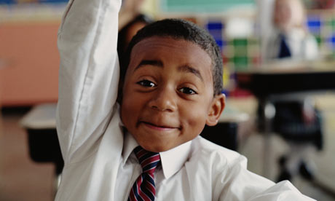
“If the Vision for Education fails to make and sustain meaningful connections between a school’s ethos and its outcomes, it will become nothing more than a deeply eloquent and well-meaning piece of writing…”

Slide 24
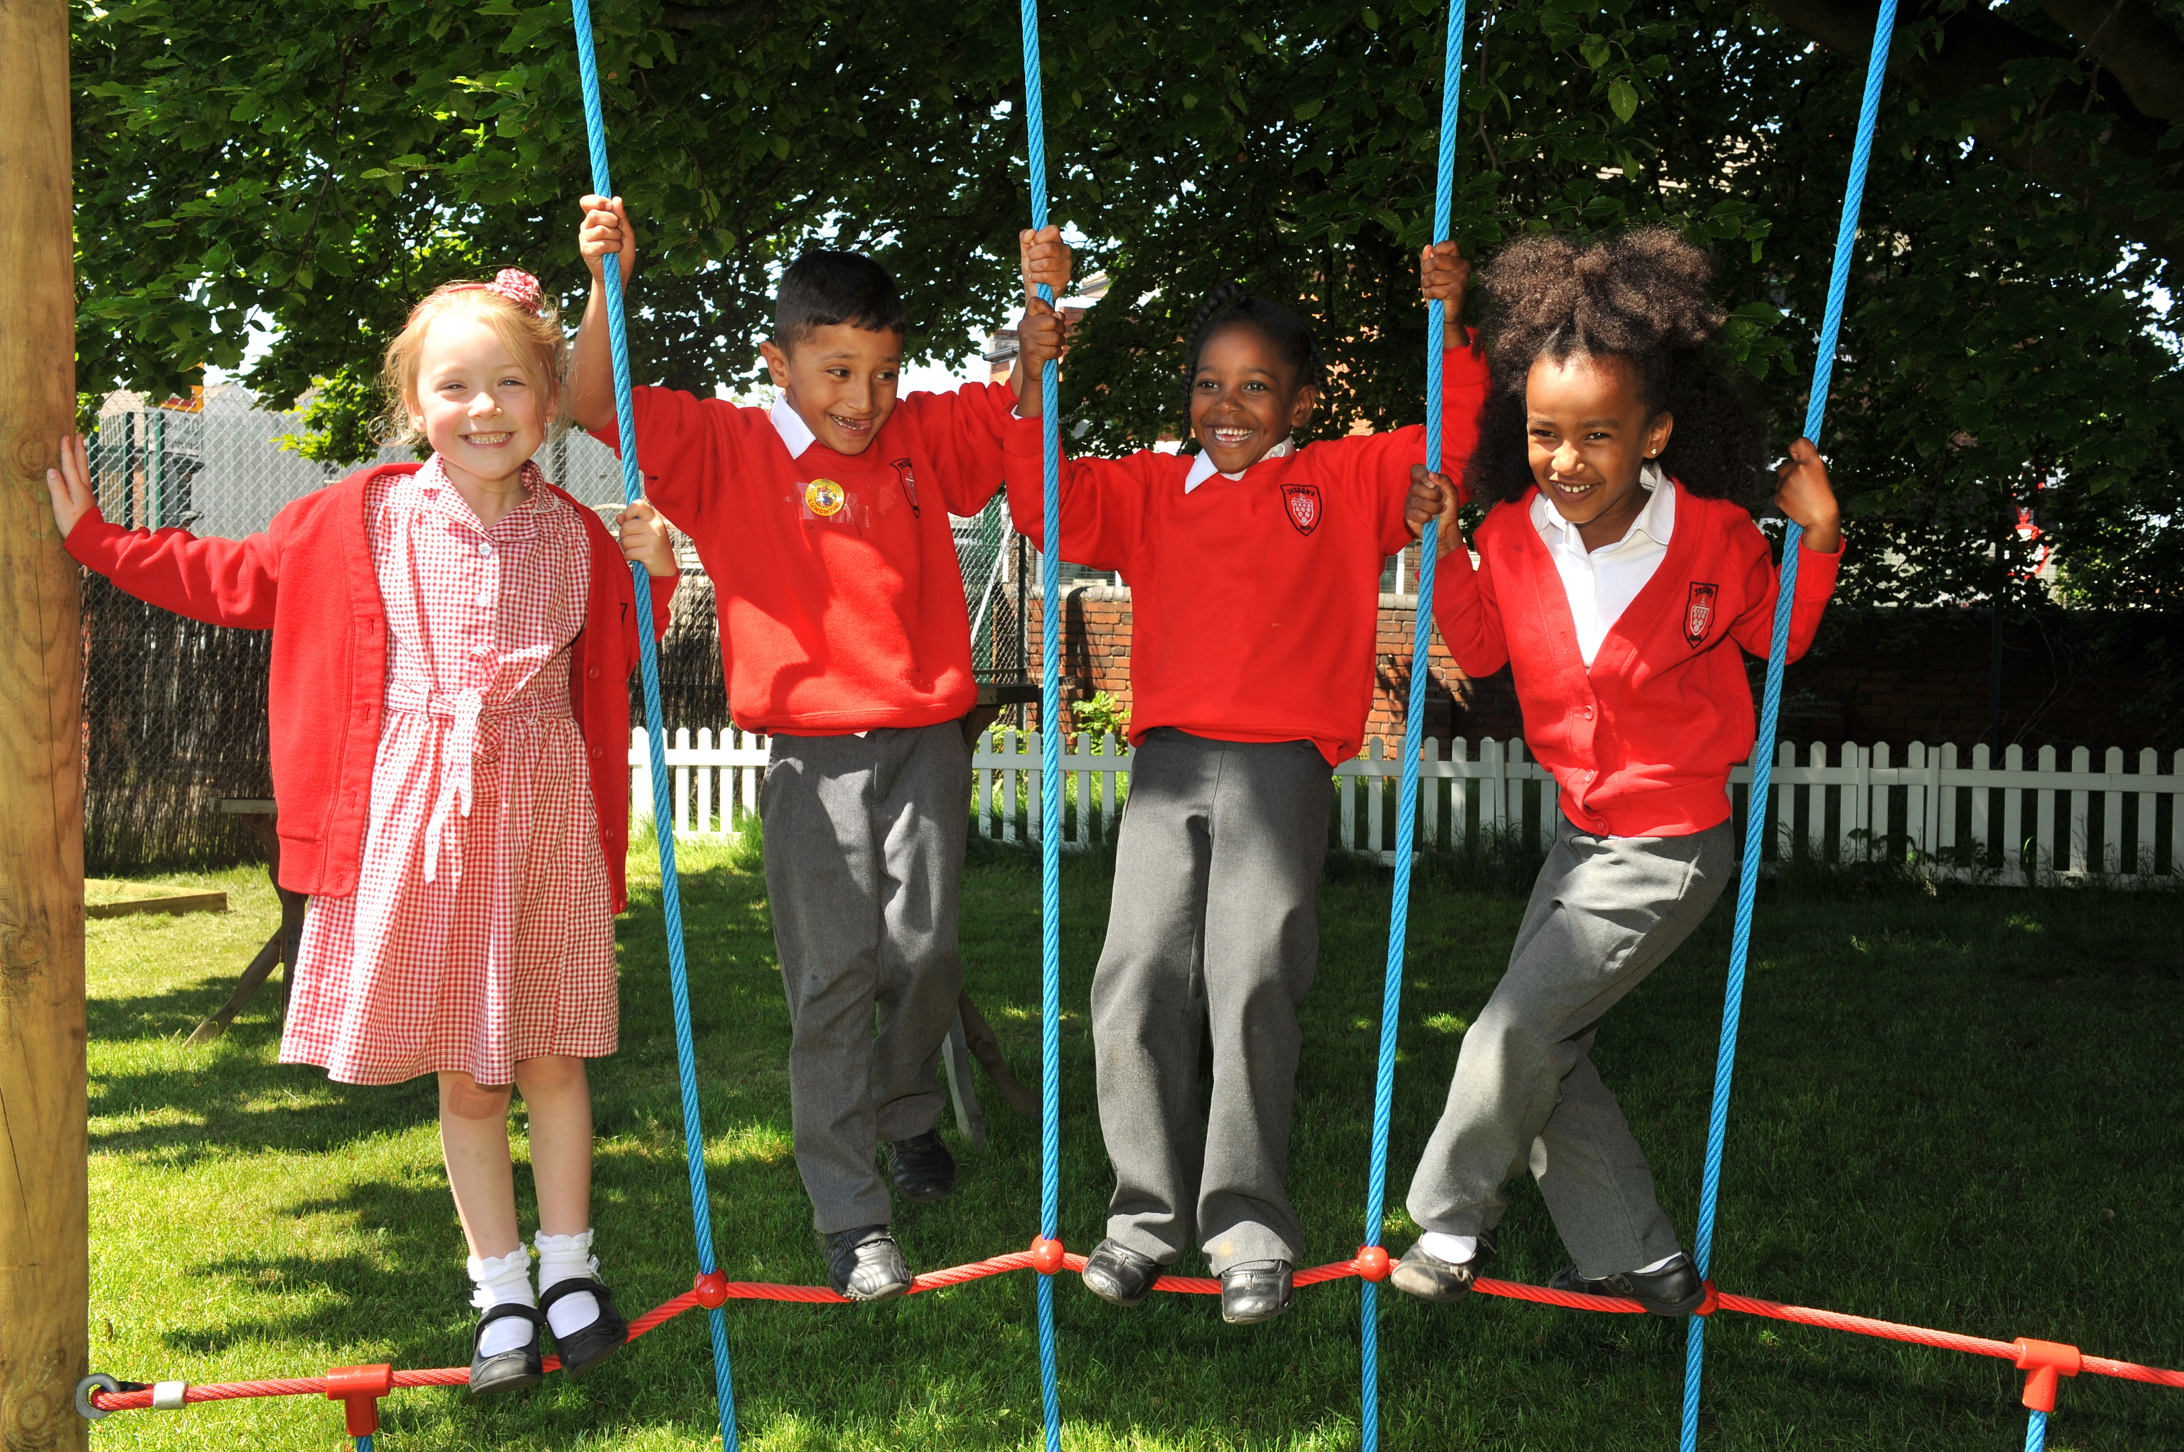
“..It must come off the shelf and be brought to life through leaders evaluating its potential impact on every area of day-to-day school life…”

Slide 25
“…This dynamic and enhancing connection between ethos and outcomes is what we mean by ‘Bringing the Vision Alive.’”

Slide 26
My hope is that the lessons of the Foundation will resonate not just within Anglican schools, but also beyond, supporting improvement right across the system.
One of those lessons, that I certainly hope echoes in schools of all faiths and none, is the Foundation’s affirmation that there should not, indeed cannot, be a trade-off between school ethos and school outcomes.
Amanda Spielman, HMCI, Feb 2018

Slide 27
What outcomes are you trying to improve?
What are the pressures and challenges?
Who defines this journey?
What help could the Vision offer you?
ethos
enhancing
outcomes
How do you define this for your school?
(in a sentence…)
Where does your ethos come from?
What are the commonalities and differences between us?
What difference does it make to your lived reality?

Slide 28
Activity: Ethos Enhancing Outcomes

Slide 29
Peer Support Network for Governors – Opportunity for 2019/20

Slide 30
Flourishing Adults, Flourishing Children

Slide 31
We flourish because of our diversity and relationships
Flourishing Teams
Flourishing Adults
Flourishing Children

Slide 32
What could this look like for Teaching and Learning?

Slide 33
Learning Plantation | Learning Rainforest
‘A right way to do things’ – set routines – e.g. L.O. on the board every lesson | Nourishing individual talents - high trust/high challenge
Leaders driven by compliance to external voices | Great variety in pedagogy and OK to try new things all the time
T+L focused on what can be examined | If creative approaches deliver, there is high level of autonomy
Data has very high status | Data is part of the picture of learning
Interventions heavily focused on short-term gains | T+L structures are dynamic/organic, aligning T+L to stated school values
Creativity becomes rules – e.g. standardised homework format etc. | Highly personalised CPD

Slide 34
We flourish because of our diversity and relationships
We flourish at different times and different speeds
Flourishing Teams
Flourishing Adults
Flourishing Children

Slide 35
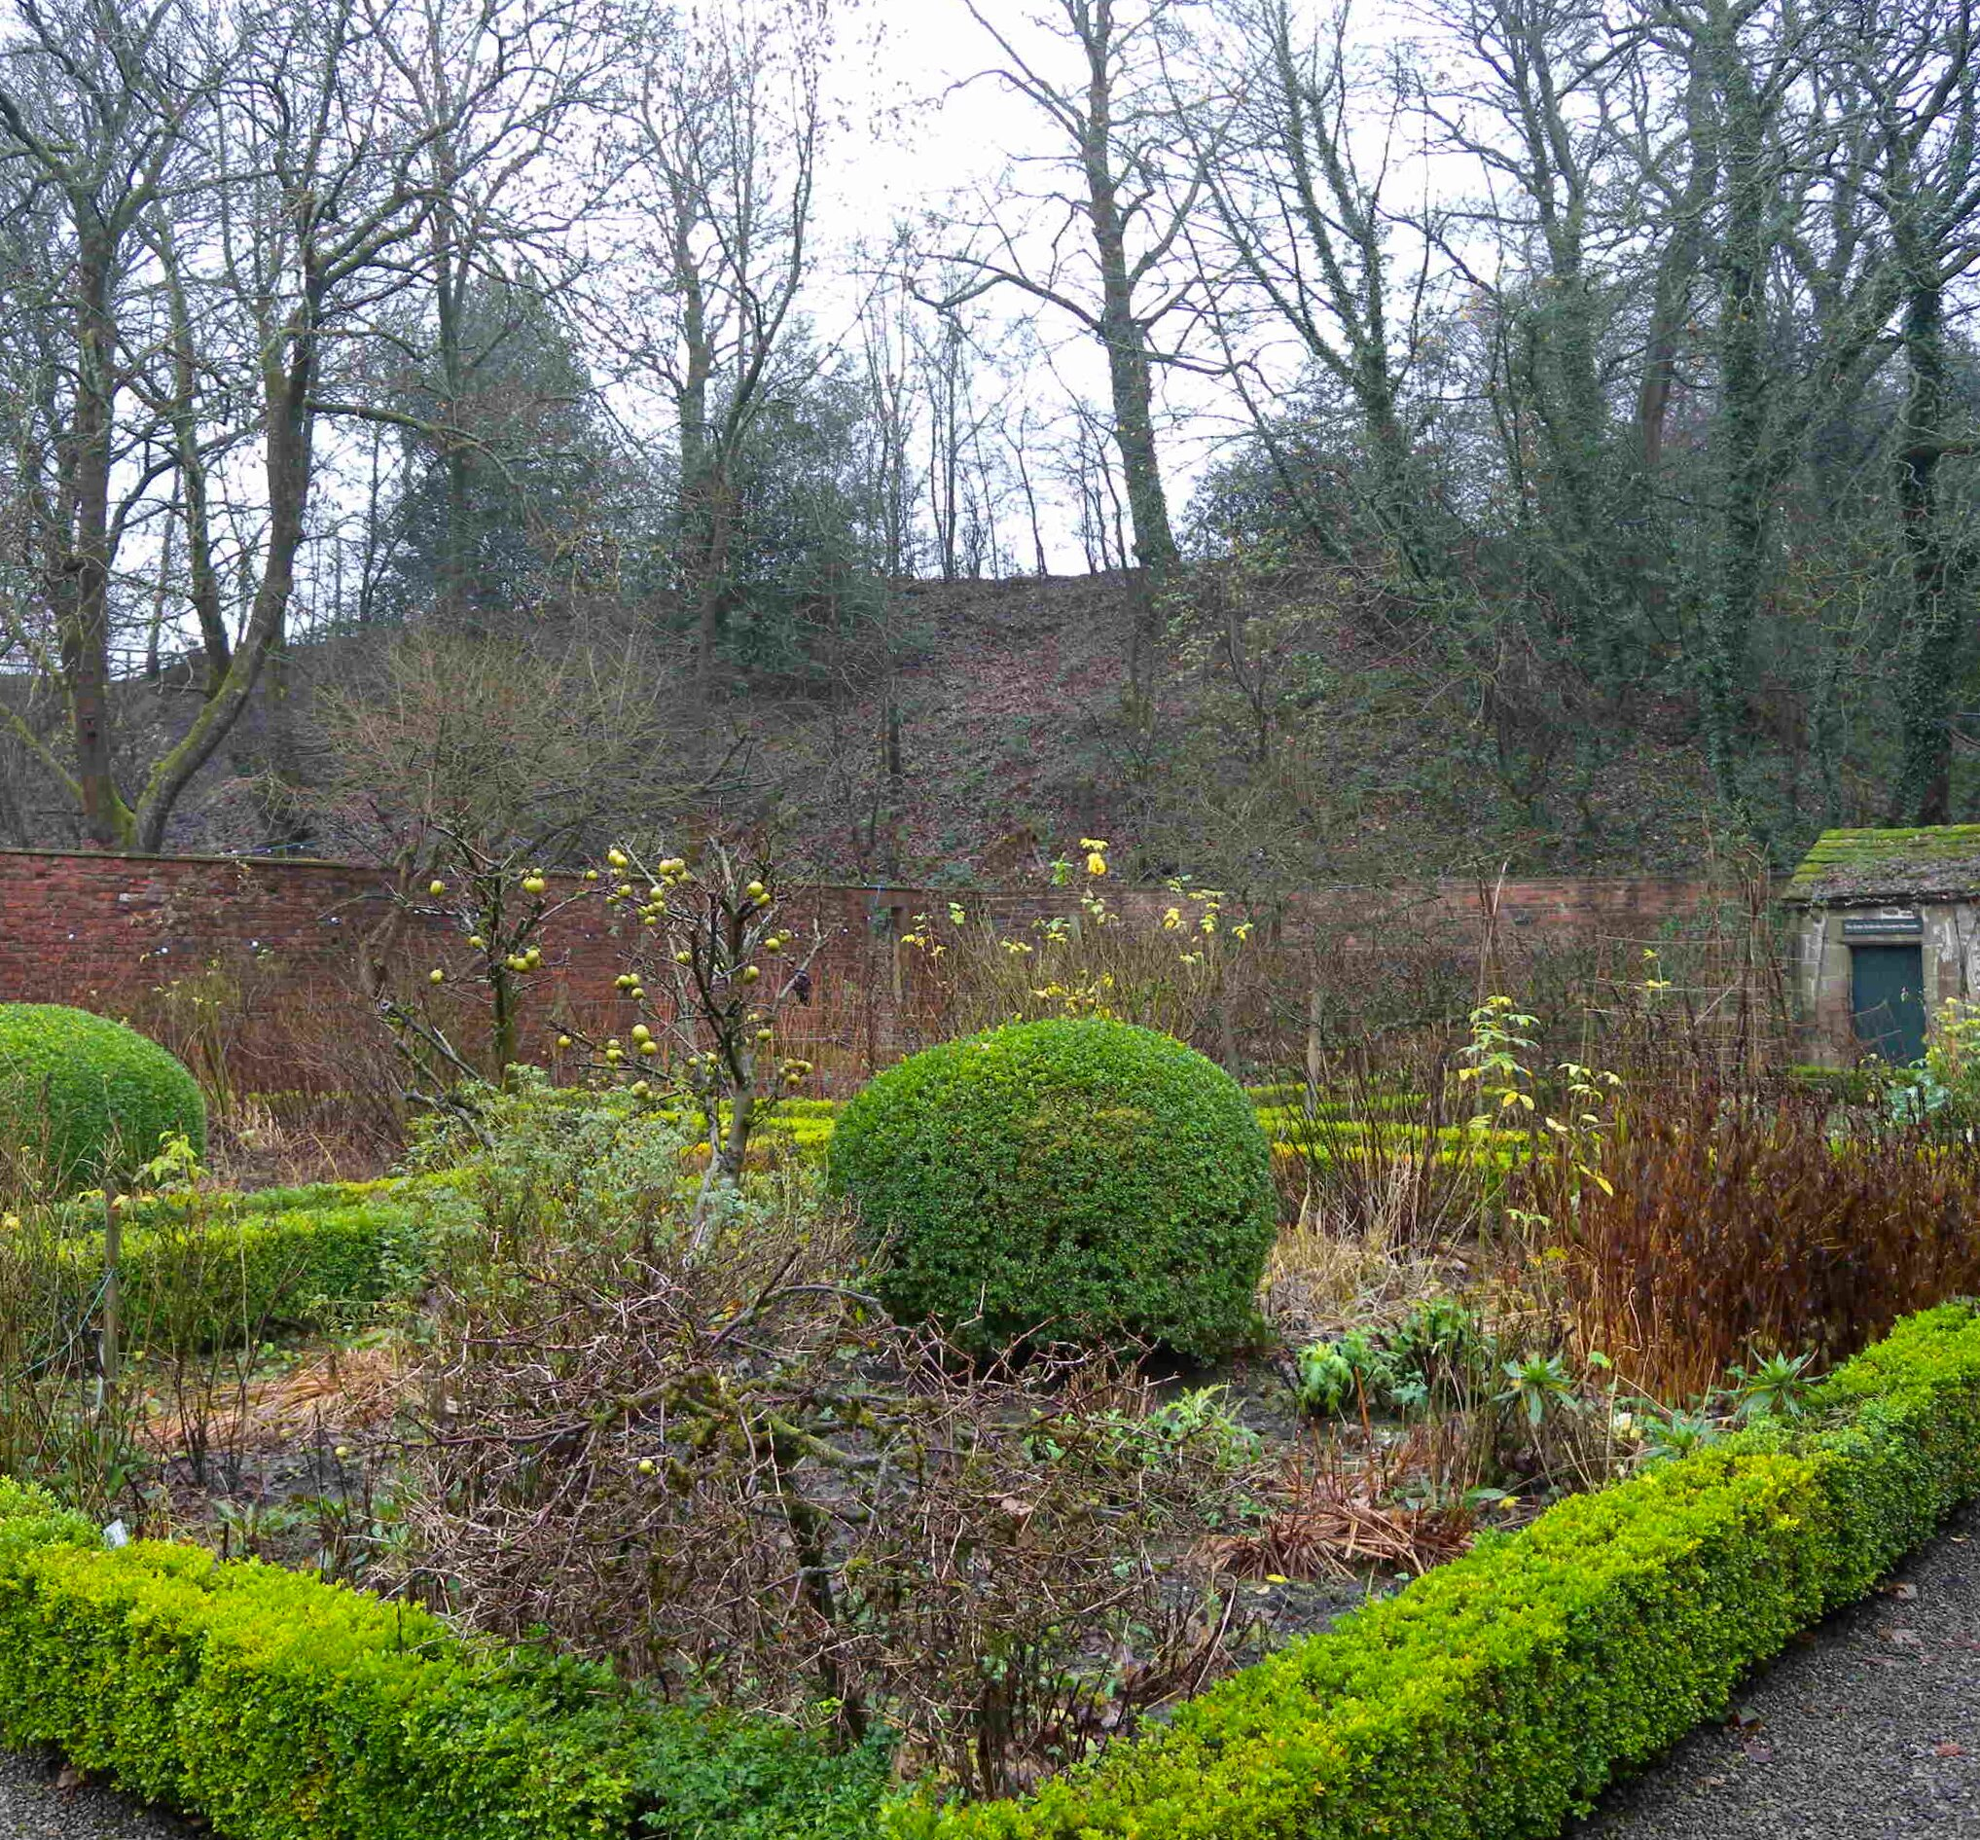
A garden that’s bursting into life…?

Slide 36
We flourish because of our diversity and relationships
We flourish at different times and different speeds
Flourishing Teams
Flourishing Adults
Flourishing Children
We flourish when we stop doing things

Slide 37
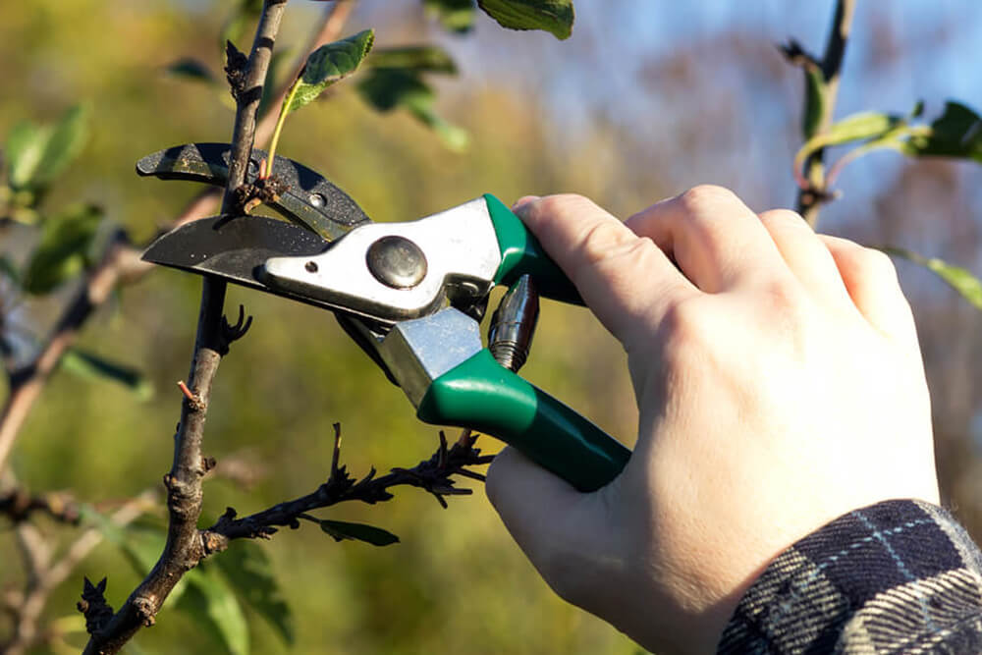
What should we stop doing?

Slide 38
We flourish because of our diversity and relationships
We flourish at different times and different speeds
Flourishing Teams
Flourishing Adults
We flourish so we can look outwards and give
Flourishing Children
We flourish when we stop doing things

Slide 39
“But since you excel in everything – in faith, in speech, in knowledge, in complete earnestness and in the love we have kindled in you – see that you also excel in this grace of giving.”
(2 Corinthians 8.7)

Slide 40
We flourish because of our diversity and relationships
We flourish at different times and different speeds
Flourishing Teams
Flourishing Adults
We flourish so we can look outwards and give
Flourishing Children
We flourish when we stop doing things

Slide 41
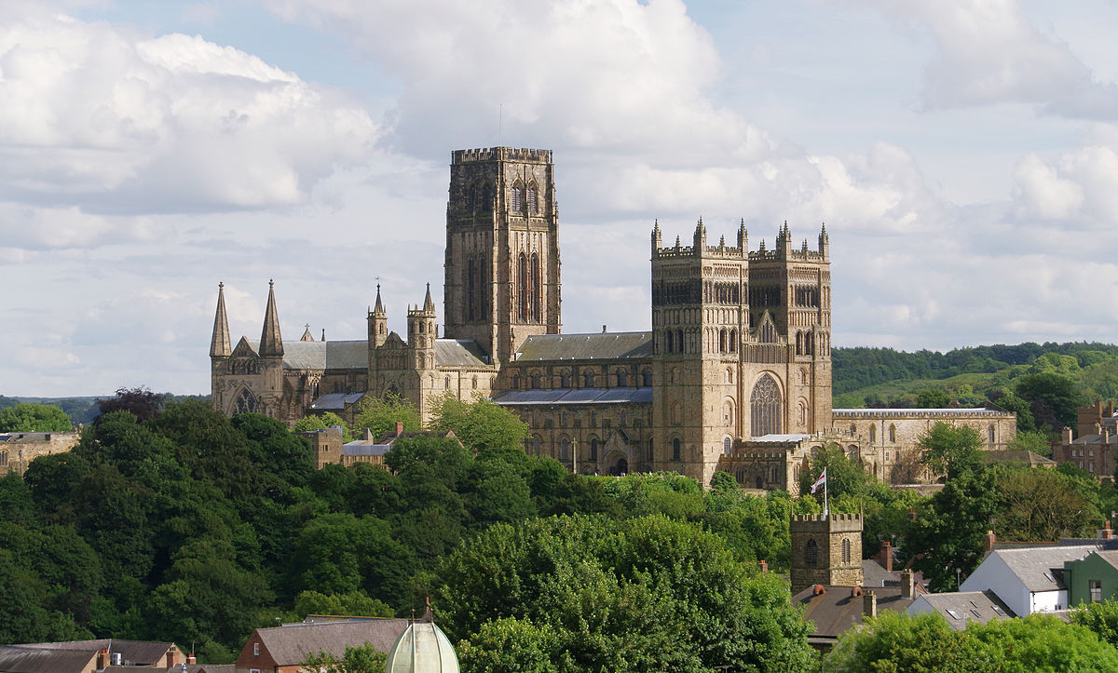
Building cathedrals…?

Slide 42
Refreshments

Slide 43
Michael Mill
Diocesan Director of Education
Delivering the Vision in schools: Equipping and resourcing governance
July 2019

Slide 44
This Photo by Unknown Author is licensed under CC BY-NC-ND

Slide 45
‘Deeply Christian, Serving the Common Good’ – published Autumn 2016
Leadership, Pedagogy and Theology brought together
Clear vision for education for all schools, not just church schools
Educating for life in all its fullness
July 2019

Slide 46
‘Life in all its fullness’
Educating for Wisdom, Knowledge and Skills
Educating for
Hope and Aspiration
Educating for Community and Living Well Together
Educating for Dignity and Respect
July 2019

Slide 47
Working with Synod, Bishop’s Council and DBE
Consulting widely
The House of Bishops’ Vision: Growing Faith in churches, schools and households
July 2019

Slide 48
If we forget our “WHY” then we will fail (eventually)
HOW we do what we do really matters
WHAT we do matters
but our WHY drives them both, and is vital
July 2019

Slide 49
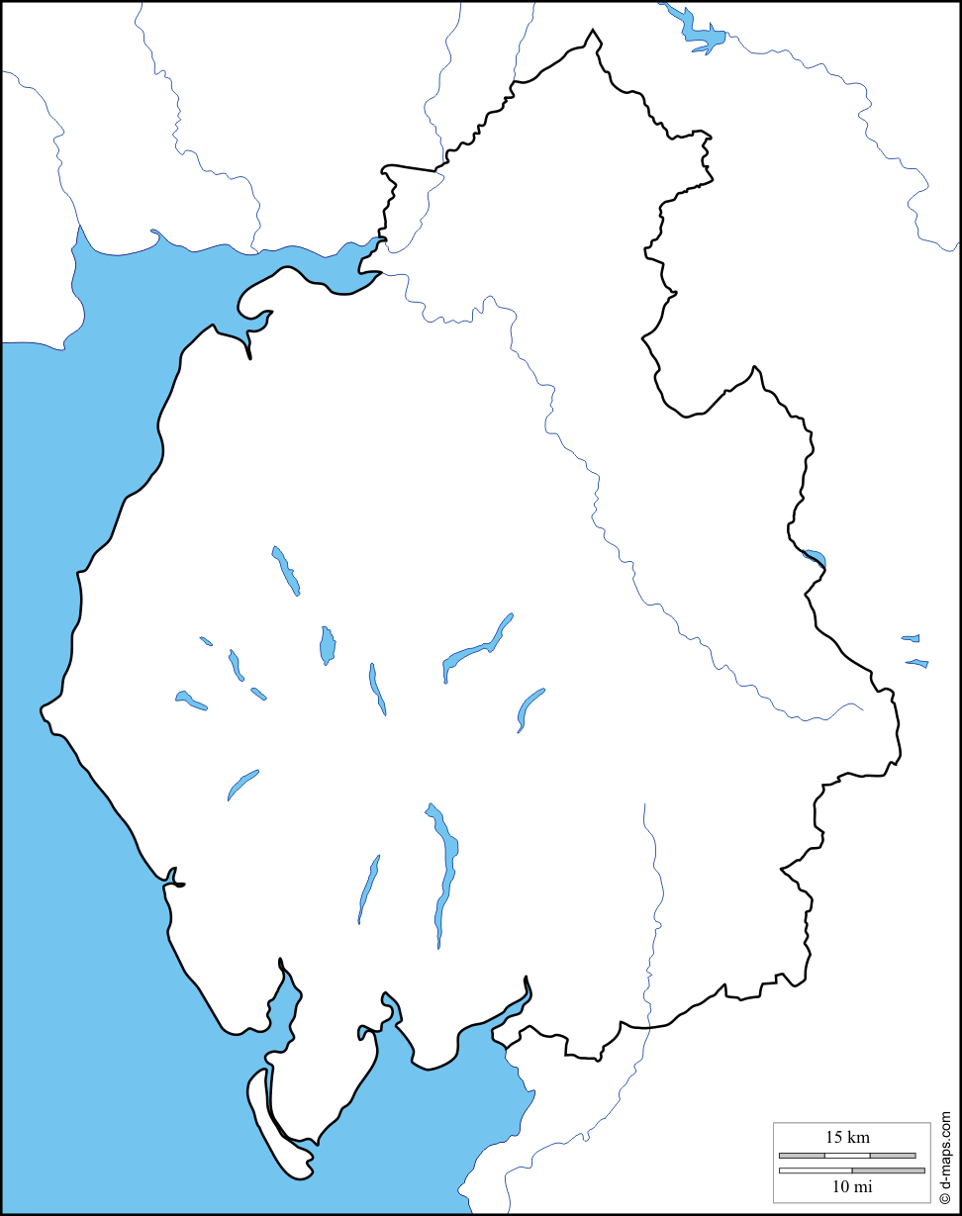
C of E Vision
for Education
God for All
Aim = changed lives on the ground
& renewed local communities

Slide 50
Rolls falling, particularly in rural areas.
An ongoing reduction in school funding.
The complexities of national movements towards new structures for school organisation.
The different impacts of changes in church structures, resources and deployment; fewer full time paid ministers brings an emphasis on self-­supporting ministers and lay ministry, and affects the number of governors, whilst also providing a significant stimulus for greater lay involvement, and opportunities to do things in new ways.
Our Diocese-­ and County-­wide vision of God for All, with its emphasis on mission and outreach, which encourages, expects and equips churches and church people to look outwards, including to their local schools.
July 2019

Slide 51
‘Growing Faith’
Growing Faith in Schools
Growing Faith ‘separately’ in Schools, Churches and Households
One could quite easily imagine an effective approach that focused on developing work in each of these 3 discrete areas
Growing Faith in Churches
Growing Faith in Households
Some of our GF activities may indeed focus on the empowering of work within each circle
Notes:
In many ways, the join up between the 3 sections could make this work much more difficult, and one could argue the case for 3 separate projects that sought to impact each of the 3 areas, with little interaction.
However….

Slide 52
Schools
Households
Churches
The
Growing Faith Intersection
However, our primary focus for Growing Faith is the intersection between 2 or more of the elements
Our understanding of young people’s faith development is that it much more likely to happen, and be sustained if it happens in the intersection
Notes:
Showing the USP of GF approach – i.e. what happens in the intersections…

Slide 53
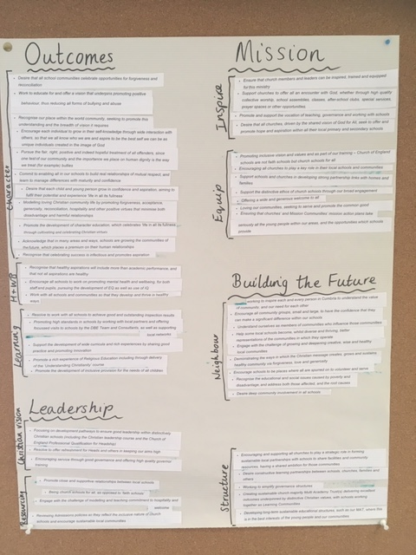
July 2019

Slide 54
Schools’ Outcomes + Character (grace)
+ Health and Well-Being (children of God)
+ Learning (growing)
Shared Leadership + Christian Vision (prophetic voice)
+ Resourcing (reservoirs of hope)
Local Mission+ Inspire (disciple)
+ Equip (commission)
Building the Future + Neighbour(hood) (love)
+ Structure(s) (eternity)
July 2019

Slide 55
And so far………
What if we are inclusive – admissions policy
What do we expect of a leader in schools – appointments
What does it mean to ‘Live Well Together’? Code of Conduct
What else? Policies
July 2019

Slide 56
Area of activity 1 Schools’ Outcomes
Focus: Character (grace)
The challenge – we should expect all in our schools to understand what Christian character means – including Christian values and virtues (forgiveness, acceptance, generosity)
What to do | How | Who
Promote the development of character education in all schools | Role out of Peer Support Network (PSN) focussed around ethos enhancing outcomes Support ethos/values days in (clusters of) schools – encourage and roll out good practice Bishop’s Award annually with different focus each year | CEFEL Schools with DBE promotion DBE led/liaison with G4L
Provide focus on relevant SIAMS themes | In particular provide resources and focus on global neighbours, justice and courageous advocacy (link to Bishop’s Award) and monitor school outcomes | Consultant commission
Provide a new focus on character within school policy making | Work with schools to develop a model behaviour policy for schools based on Vision for Education (V4E), including exclusions Consider other policies/advice document | DBE with schools
July 2019

Slide 57
3 key priorities
Sustainable schools
Health and well being
Governance
July 2019

Slide 58
The vision is to inspire (disciple) and resource (as reservoirs of hope) church and school leaders, including governors and prospective governors.
Discussion 1
Promotion of the role of foundation governor as a vocation/calling.
How do we promote the status and celebrate work of Foundation governors – (commissioning / saying ‘thank you’. Working with Mission communities)
Where should Foundation governors come from?
July 2019

Slide 59
Discussion 2
Review the principles, purpose and role of Ex officio governor.
i. A key connector of threads – people, structures, church/parish links
ii. Foundation governors support the Christian ethos and character of the school
iii. Being a sounding board, a listening ear, bringing a faith/church perspective to governance
iv. Governance is a chance to understand the school’s inner workings from a different perspective; this can offer insights that connect to the school incumbent and pastoral aspects of the clergy role.
The issues…….is this a role we welcome?
What do we do going forward with fewer full time paid clergy?
How is this addressed in Mission Communities/Parishes?
What does clergy training (and appointments) look like what do they need before and during ministry?
July 2019

Slide 60
Discussion 3
Facilitating the appointment, reappointment (and potential removal) of foundation governors, for governors in CE schools.
What works and what doesn’t? What requires further clarification?
How do we match skills school needs to the requirement for ‘Foundation Governors’
July 2019

Slide 61
Discussion 4
Resourcing those who serve as foundation governors through providing ongoing guidance and training to support their role.
(on-line training, induction pack, modules, more diocesan guidance, events)
How can we do this and what does it look like?
July 2019

Slide 62
Other priorities
Health and well being
Look after our Headteachers and watch for their bad habits
Putting yourself and your needs last
Feeling you have to provide all the answers
Not making time for reflection
Not seeking support when you need it most
July 2019

Slide 63
Vision without action is merely a dream. Action without vision just passes the time. Vision with action can change the world.
Joel Barker
July 2019

Slide 64
This Photo by Unknown Author is licensed under CC BY-NC-ND

